Slide 1
Introduction: Terminologies and Concepts

Slide 2
Terminology
Assets: things that we want to protect such as our data, software and hardware.
Vulnerabilities: are weaknesses in a system that might be exploited in order to cause loss or harm, e.g., a file server that does not authenticate it’s users.
Threat: a loss/harm that might befall a system, e.g., users’ personal info might be revealed to public or your car may get stolen.
Attack: an action that exploits a vulnerability, e.g., pretending to a file server that you are a different user so that you can modify files.
Control: to remove/reduce a vulnerability so that we can prevent an attack and block a threat.

Slide 3
Security and Privacy
Security means CIA:
Confidentiality: access to the system or data is limited to parties who have been authorized.
Integrity: when the user requests for data, he or she receives the right data.
Availability: the system or data is available whenever the user wants to use it.
A computing system is secure if it has all the three properties. In fact, a secure system is one you can rely on, i.e., reliability.
Privacy means:
The ability to control information about you, e.g., who see/use it.

Slide 4
Penetration and Protection
Principle of Easiest Penetration:
The attackers go after the part of the system that is easiest for them, not most convenient for you.
Therefore, you need to learn how to think like an attacker like white hat hackers.
Principle of Adequate Protection:
Do not spend $10,000 to protect a computing system that can only cause $100 in damage, i.e., economics of security.
For instance, protect our data by making it unreadable to an attacker, or apply cryptographic protocols to authenticate transactions, etc.

Slide 5
Method of Defence
How can we defend against a threat?
Prevent it: block the attack at the first place.
Deter it: make the attack harder/expensive.
Deflect it: make yourself less attractive to attackers.
How can we defend against an attack?
Detect it: notice that attack is occurring/has occurred.
Recover from it: mitigate the effects of the attack.

Slide 6
Defence of Computer Systems
We can protect our assets by:
Cryptographic Techniques: for instance, authenticating our users by using digital signatures, etc.
Software Controls: passwords and other forms of access control, virus scanners, personal firewalls, etc.
Hardware Controls: fingerprint readers, smart tokens, etc.
Physical Controls: locks, guards, off-site backups, etc.
Policies and Procedures: prevent an employee to connect his own Wi-Fi access point to the internal company network, etc.

Slide 7
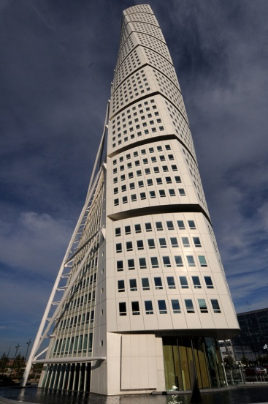
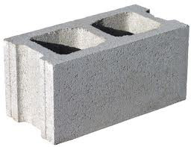

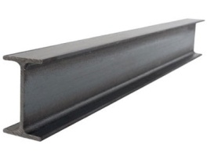
Cryptographic Primitives
Concrete Block
Brick
Steel Beam
Material Scientists
Engineers and Architects
Secret Sharing Schemes
Sealed-Bid
Auctions
Bids
Winner and Selling Price
Commitment Schemes
...
Signature Schemes
Computer Scientists and Mathematicians
Software/Security System Engineers

Slide 8
Evaluation of the Primitives
“Passive” versus “Active” Adversary Model:
In the former, players follow protocols correctly but are curious to learn the secret. In the latter, players may also deviate from the protocols.
“Static” versus “Mobile” Adversary Model:
In the former, the adversary corrupts players ahead of time. In the latter, the adversary corrupts different players while the protocol is executing.
“Computational” versus “Unconditional” Security:
In the former, security relies on computational assumptions (e.g., factoring). In the latter, adversary has unlimited computational power.
Other Issues To Be Considered:
Computation and communication complexities, players’ types (honest/semi-honest/malicious, selfish/unselfish, reputable/new/non-reputable).

Slide 9
Secret Sharing Scheme
Sharing: a secret is divided into n shares in order to be distributed among n players.
Reconstruction: an authorize subset of players then cooperate to reveal the secret, e.g., t players where t < n is the threshold.
Example: t = 2 points are sufficient to define a line:
( 1, 2 ), ( 2, 3 ), ( 3, 4 ), ( 4, 5 ) → y = x+1
t = 3 points are sufficient to define a parabola.
t = 4 points are sufficient to define a cubic curve.
In general, it takes t points to define a polynomial of degree t-1.
Secret = 1

Slide 10
Rational SS & Commitment Scheme
Rational Secret Sharing: f (x) = 3 + 2 x + x² t=3 shares are required.
Model: players are selfish rather than being honest or malicious.
Commitment Scheme:
Commit: in a commitment scheme, the first party (Bob) initially commits to a value while keeping this value hidden.
Reveal: then, he reveals the committed value to the second party (Alice) in order to be checked.
P_{j}
selfish
P_{i}
11
6
P_{k}
18
6
11
only P_{k} learns the secret “3”
Bob
Head/Tail
Alice
can not change it, just reveal it
Head

